Slide 1
Common Cloud Vulnerabilities
Rodney Beede BSides SATX 2021

Slide 2
Abstract
Technical walkthroughs of common cloud application and environment vulnerabilities. Demonstrations of vulnerable systems in a cloud, how attackers exploit them, and preventative recommendations.
https://www.rodneybeede.com/curriculum%20vitae/bio.html

Slide 3
Agenda
Vulnerabilities such as:
Insecure Object Storage
Why this is still an issue?
Newer mitigating controls today
SSRF (Server-Side Request Forgery)
Metadata URL leaks
Internal VPC network scanning
Exploit detection and alarming
IAM Permission Pitfalls
Mistakes made by customers that permit unexpected actions
Assume a role of world power
Deny vs Allow
When is a deny not the end?
API Key Theft and Backdoors to Watch Out for
Source code, Instance roles, etc.
How a backdoor is installed
What to look for in a compromised account
JSONP Theft
The road to stolen SaaS
Supply Chain (e.g. third party library) Dependency Exploits
Lack of MFA
Compromising your password resets
Attacking your SAML/Federation identity
Do your policies check if 2FA was used?

Slide 4
Quick Terminology
IaaS = Infrastructure as a Service
SaaS = Software as a Service
EC2 == Compute
Bucket = Object Storage
Different cloud vendor terms, same principals

Slide 5
Insecure Object Storage
See it in the news time and time again
Why insecure ACL settings?
Sharing a bucket publicly to the world
Guess the DNS name and you get access
Find the name embedded in code
During dev it’s easy to just share publicly
Meant to restrict it for prod release later
Confusing User Interfaces
...

Slide 6
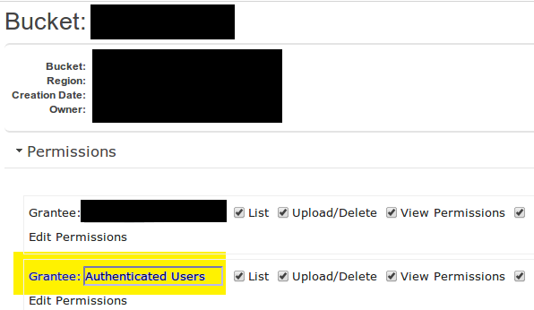
Historically Confusing UI
Who are “Authenticated Users?”

Slide 7
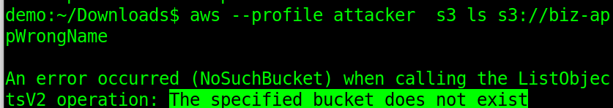
Walkthrough: Object Storage Vulnerability
http://biz-app-prod.s3.us-east-2.amazonaws.com/

Slide 8

Demo - Object Storage
Demo - Object Storage
(quality may be better if you download the video locally for playback)

Slide 9
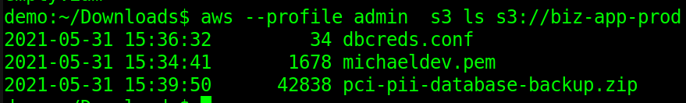
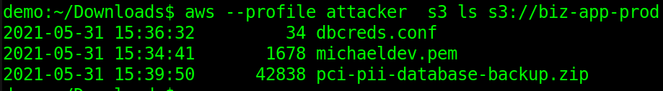
Demo - (Offline Backup)
Legit User
Attacker (accidental data leak)

Slide 10
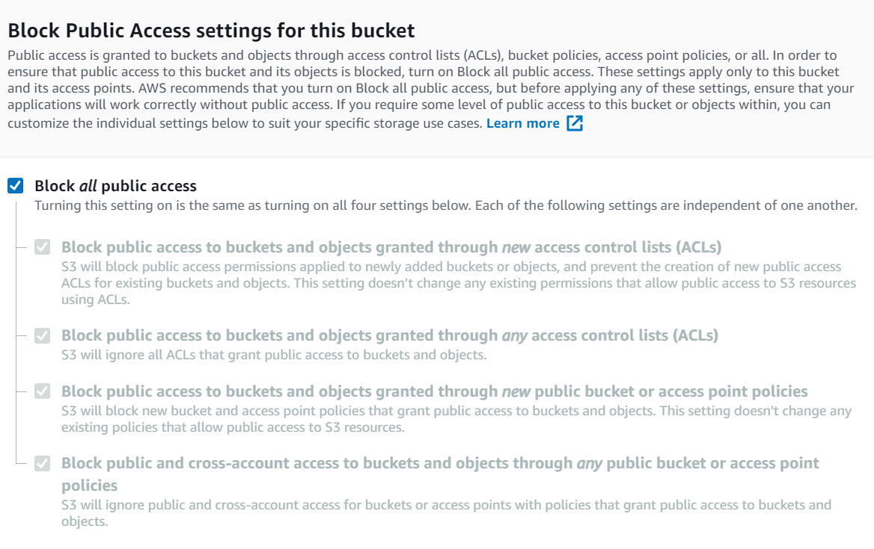
Modern Day Improvements

Slide 11
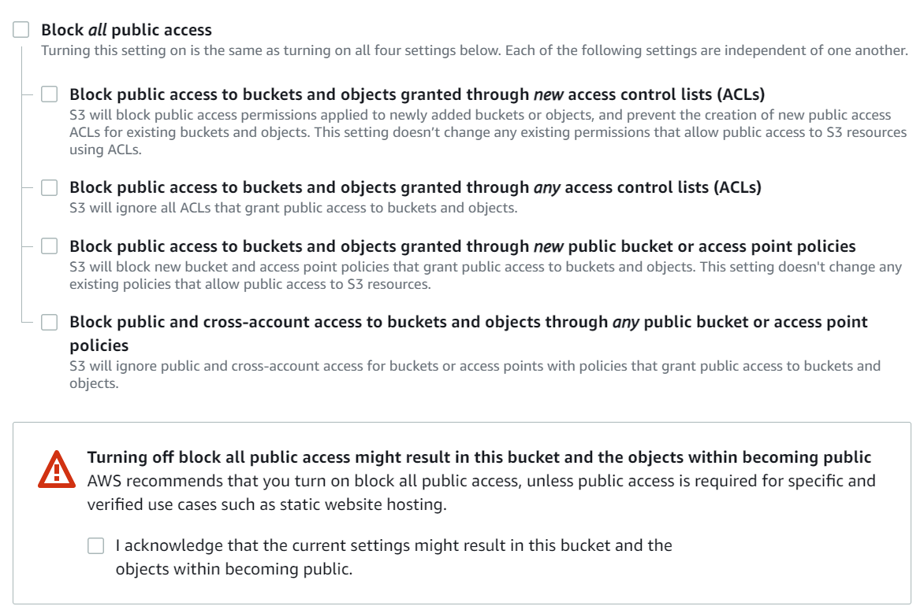

Slide 12
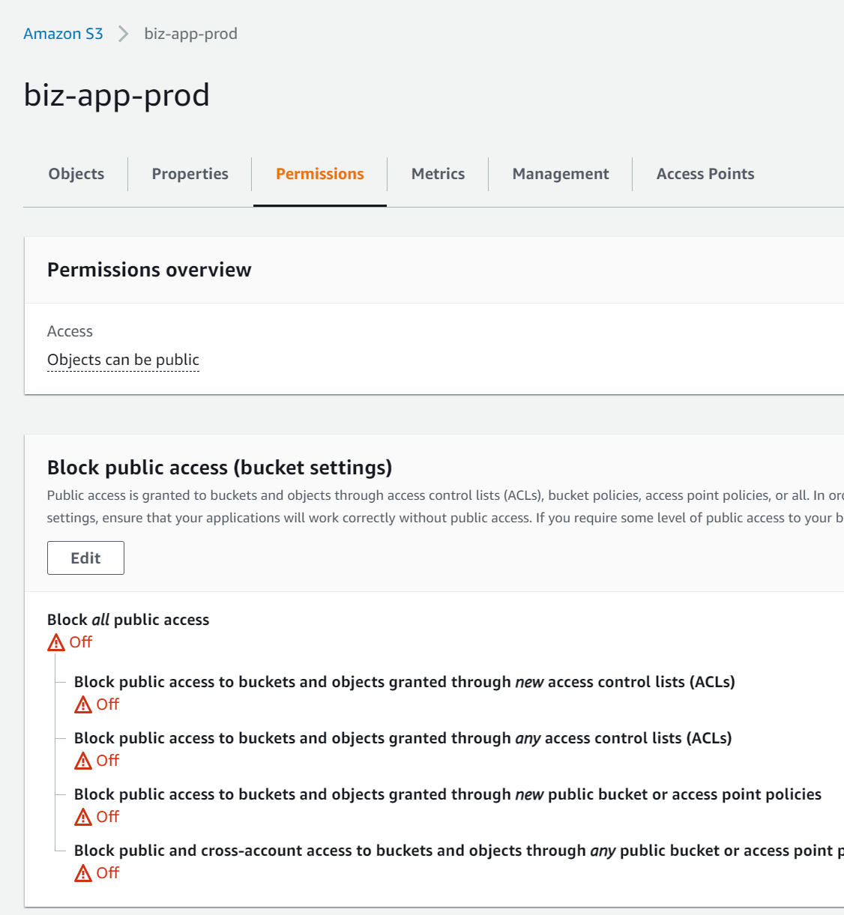

Slide 13
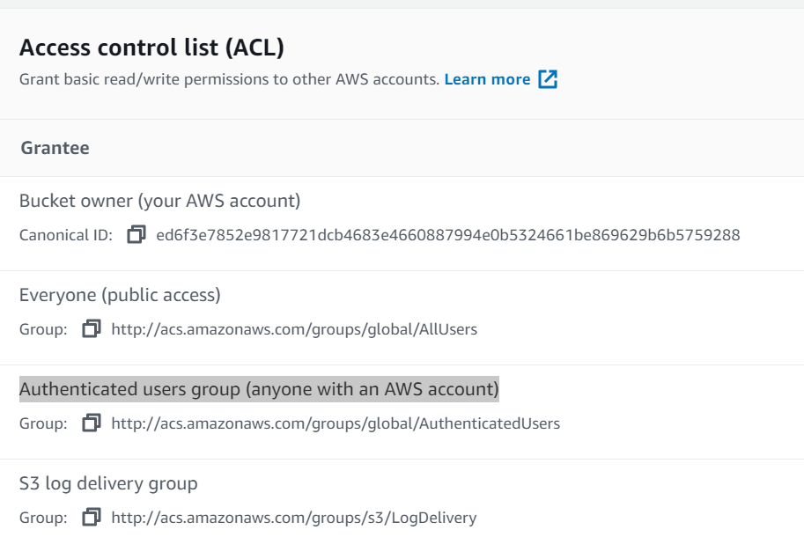

Slide 14
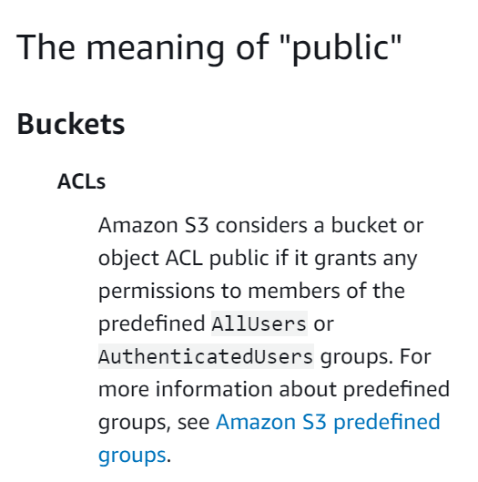
https://docs.aws.amazon.com/AmazonS3/latest/userguide/access-control-block-public-access.html

Slide 15
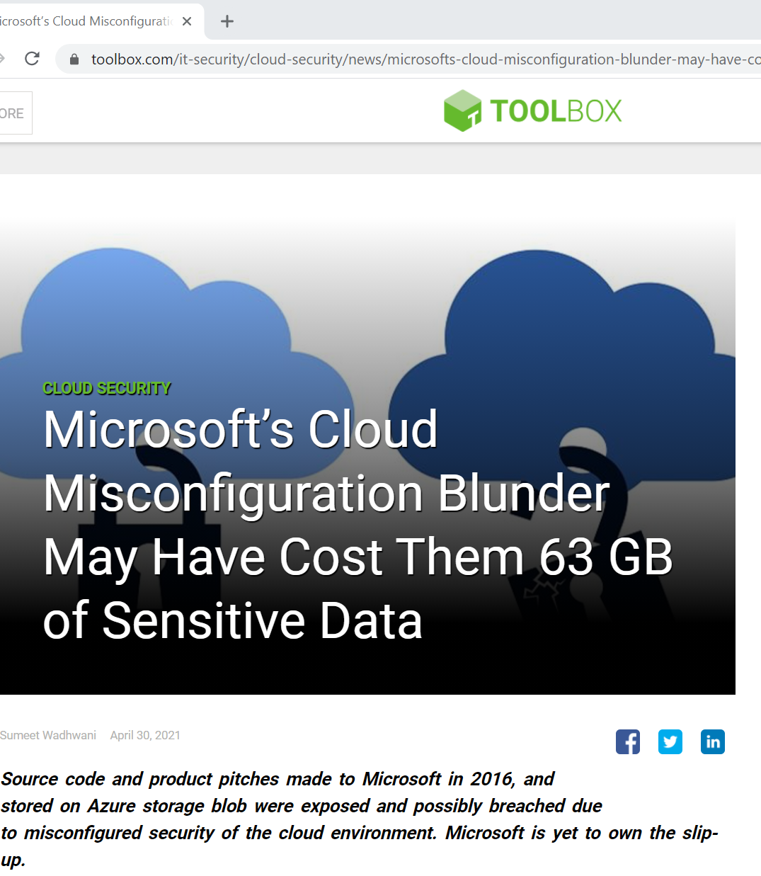
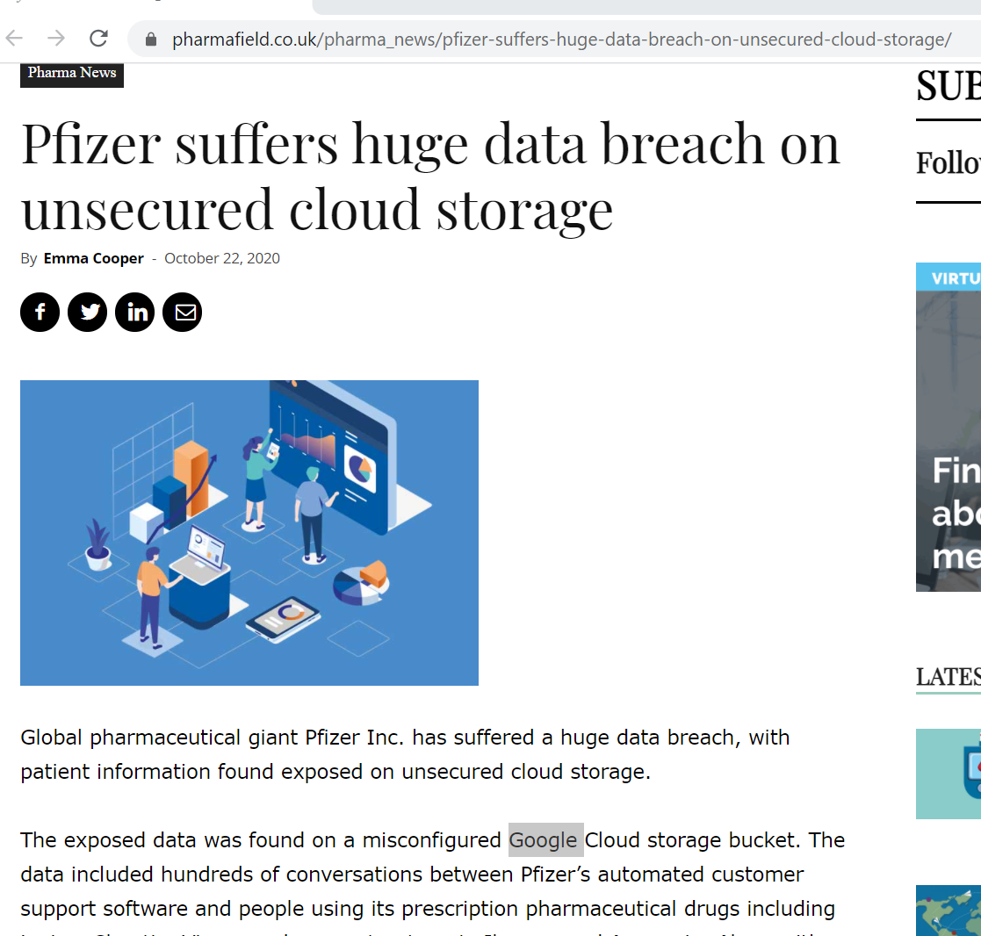
Not Just AWS - Other Cloud Vendors
Google

Slide 16

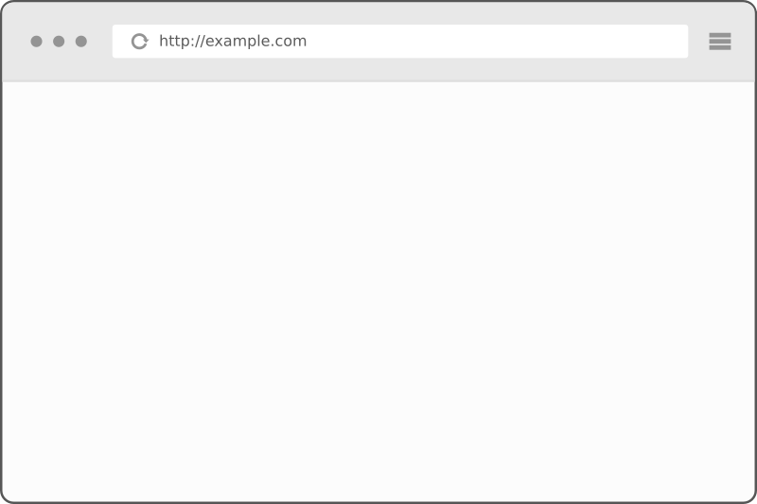

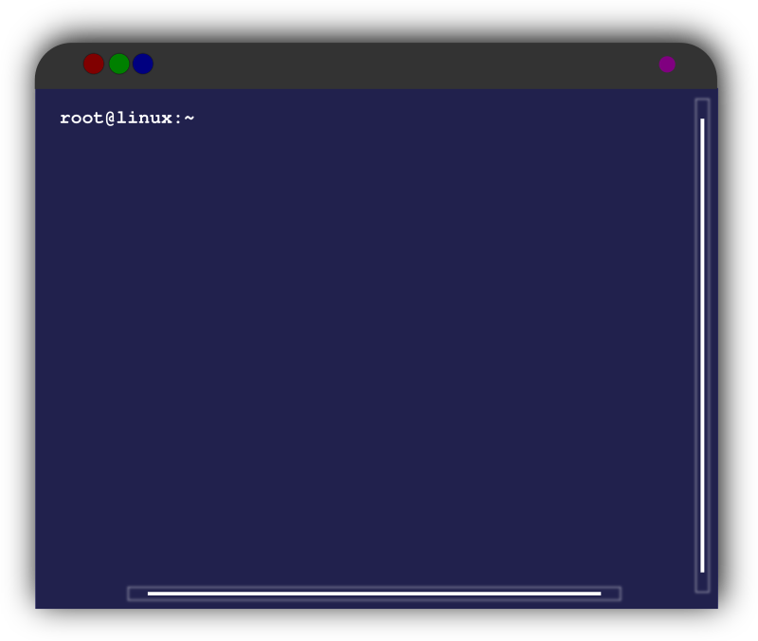
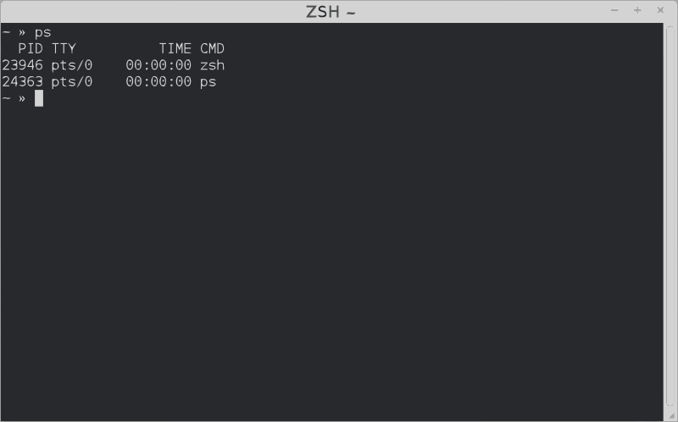
SSRF (Server-Side Request Forgery)
Abuse functionality on the server
Read or update internal resources
Attacker supplies a URL to the web server
Returns sensitive internal information
(https://owasp.org/www-community/attacks/Server_Side_Request_Forgery)
https://example.com/qparam=http://10.2.3.4:8888/admin/console.cgi
Internal Only Servers
Attacker
Firewall Allows port 443
Vulnerable Website

Slide 17
Nothing New
SSRF is a well known vulnerability
Many have documented cloud metadata attacks
Recommend BSidesSATX 2019 talk “There’s No Place Like 169.254.169.254 Ab(using) Cloud Metadata URLs” by Brennon Thomas
https://github.com/opsdisk/cloud_metadata_extractor/blob/master/abusing_cloud_metadata_urls-bsides_satx_2019.pdf
Well known, but not always easy
Requires web site to have “web browser” like functionality
Or poorly configured HTTP load balancer / reverse proxy
Downloading resource on behalf of user
XML XXE injection
SSRF -> Internal Network Access
Port scanning, accessing other servers protocols, etc.
Bug bounties apparently pay well for finding this

Slide 18
Metadata URLs
http://169.254.169.254/latest/meta-data/
AWS
OpenStack (also has http://fe80::a9fe:a9fe)
http://169.254.169.254/metadata/instance?api-version=2018-04-02
Azure (requires extra header so some SSRF may be limited)
http://169.254.169.254/latest/meta-data/iam/security-credentials/{role}
AWS EC2 instance profile (role) credentials
http://169.254.169.254/latest/meta-data/identity-credentials/ec2/security-credentials/ec2-instance
Another AWS credential but not typically helpful to attackers
http://metadata.google.internal/computeMetadata/v1beta1/instance/service-accounts/default/token
Google Cloud
Again, checkout https://github.com/opsdisk/cloud_metadata_extractor/
Brennon Thomas

Slide 19
Demo - SSRF
(you may need to download the video locally for best quality)

Slide 20
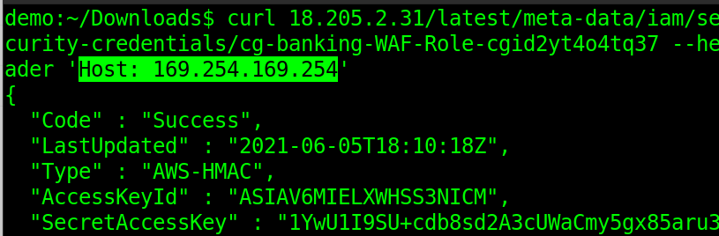
Demo (Offline Backup)

Slide 21
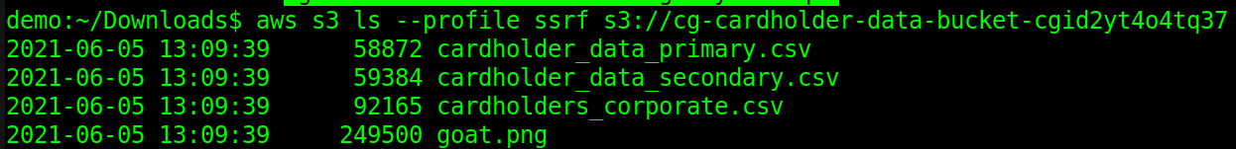
Demo - SSRF

Slide 22
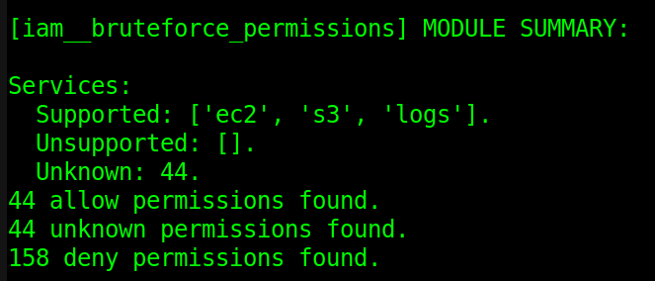
Demo - SSRF
Pacu - enumeration tool
Feed it stolen creds
It finds what you can access

Slide 23
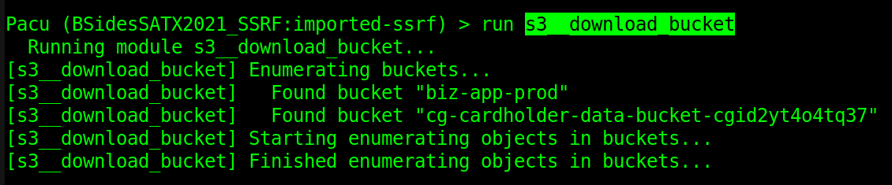
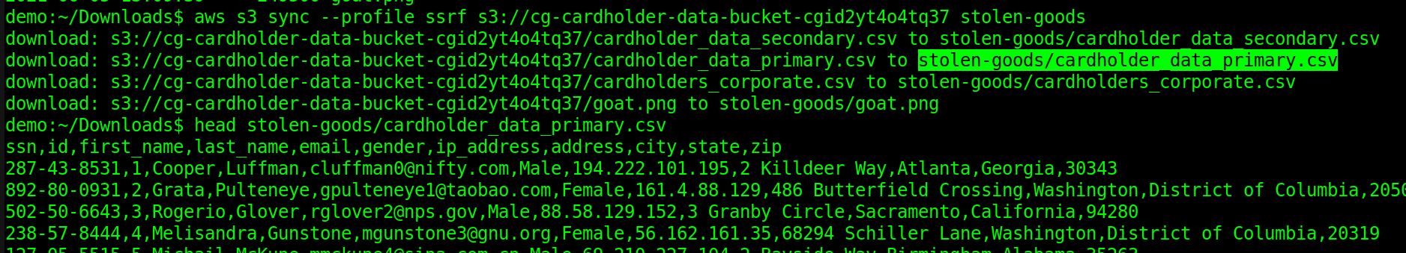
Demo - SSRF

Slide 24
Mitigations
AWS has added a defense (released 2019):
Instance Metadata Service (IMDS) turned off
IMDSv1 enabled (vulnerable to SSRF)
IMDSv2 required
Requires extra PUT to get a token
Then your request http://169.254.169.254 with token header
Thwarts SSRF because many vulnerable web apps don’t support PUT client requests
References
“Configure the instance metadata service” (https://docs.aws.amazon.com/AWSEC2/latest/UserGuide/configuring-instance-metadata-service.html)
https://aws.amazon.com/blogs/security/defense-in-depth-open-firewalls-reverse-proxies-ssrf-vulnerabilities-ec2-instance-metadata-service/

Slide 25
Mitigations - Other Clouds
Azure
Already requires extra header Metadata=true
https://docs.microsoft.com/en-us/azure/virtual-machines/windows/instance-metadata-service?tabs=windows
Google
Also requires extra header Metadata-Flavor: Google
https://cloud.google.com/compute/docs/storing-retrieving-metadata

Slide 26
Exploit Detection & Alarming
AWS GuardDuty
Unauthorized Access: IAM User/Instance Credential Exfiltration
Won’t alarm if attacker uses your creds from their own EC2 instance though
AWS CloudTrail
Add custom alarm if an API is called outside your VPC

Slide 27
IAM Permission Pitfalls
Mistakes made by customers that permit unexpected actions
Granting too much permission
Unknowingly granting permission to give permission
Let them create EC2 instances or Lambdas
They pass admin access as an instance profile/role
Not understanding to whom we gave permission
arn:aws:iam::408844262892:user/chris-cgidp2jpdix320 Not the same as
arn:aws:iam::408844262892:root And the above doesn’t mean what you think either

Slide 28
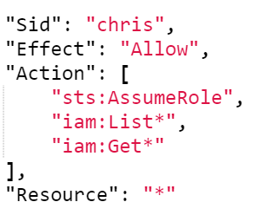
Demo - IAM Escalation
AssumeRole without a Resource restriction

Slide 29
Demo - IAM Escalation Video
(you may need to download for quality)

Slide 30
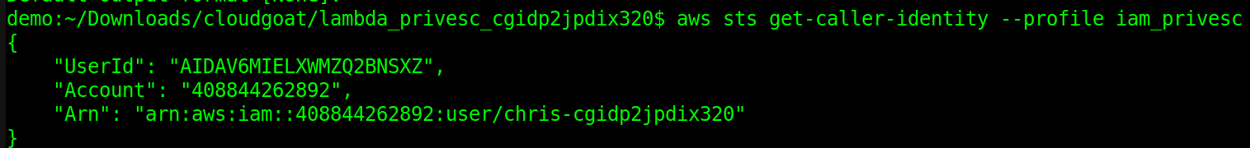
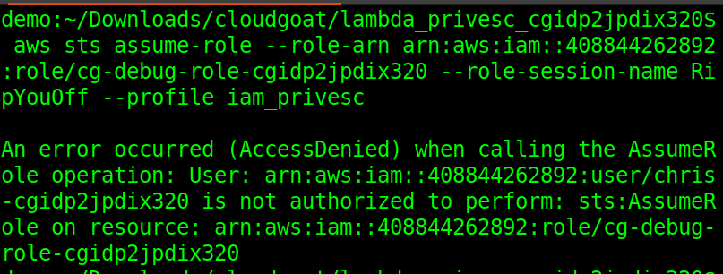
Demo (Offline) - IAM Escalation
Notes:
Chis realizes he can’t just assume a privileged role.

Slide 31
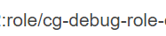
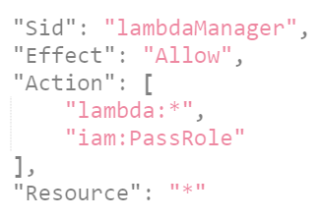
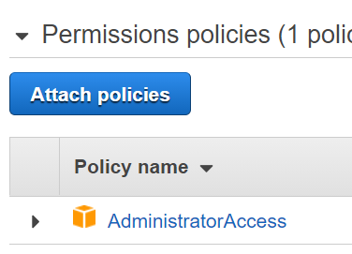
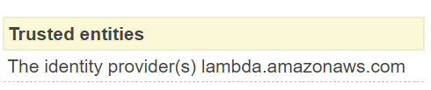
Demo (Offline) - IAM Escalation
Uses this role to get to role cg-debug-role

Slide 32
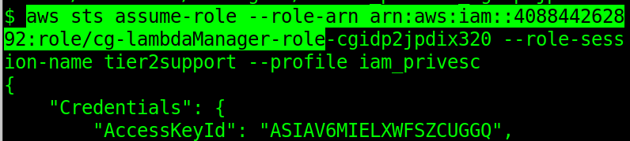
Demo (Offline) - IAM Escalation

Slide 33
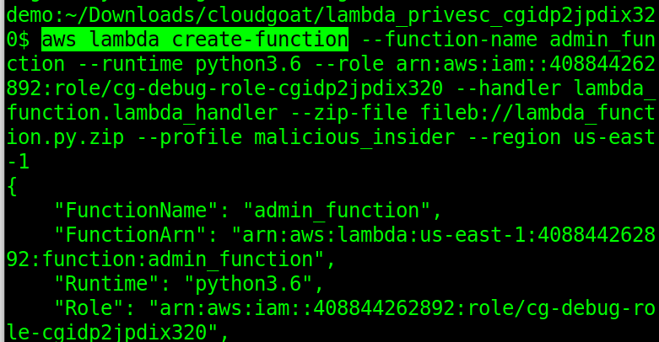
Demo (Offline) - IAM Escalation

Slide 34
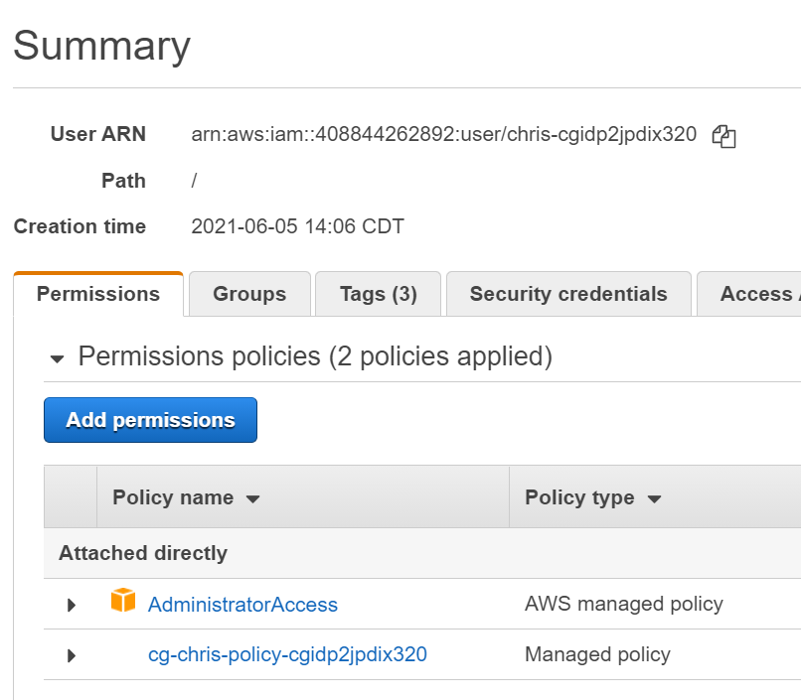
Demo (Offline) - IAM Escalation
User “chris” has maliciously added AdministratorAccess

Slide 35
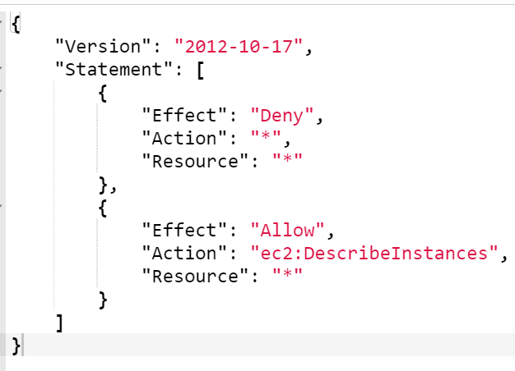
IAM - Deny vs Allow
“An explicit deny in either of these policies overrides the allow”
“Policy evaluation logic” - AWS Identity and Access Management User Guide

Slide 36

When is a Deny not the End?
VADER EPISODE 1: SHARDS OF THE PAST - A STAR WARS THEORY FAN-FILM https://www.youtube.com/watch?v=Ey68aMOV9gc

Slide 37
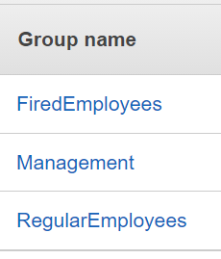
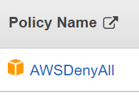
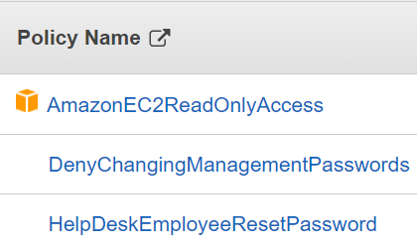
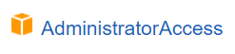
IAM Group versus User Resources
“Presenting the Risk: Do You Know About this AWS Authorization Misuse?”
Or Azarzar - https://blog.lightspin.io/aws-iam-groups-authorization-bypass
Accessed June 5, 2021

Slide 38
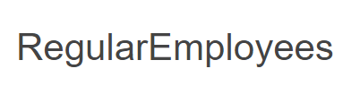
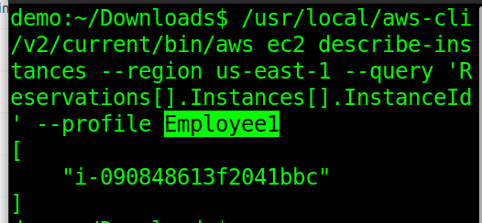
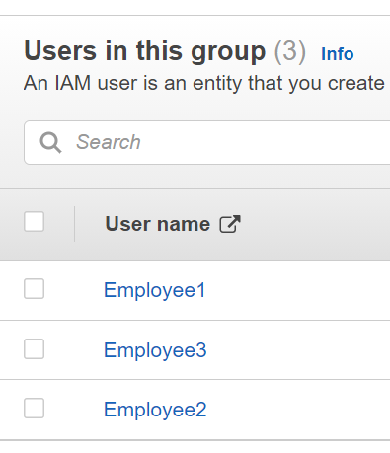
Baseline Check - Legit Employee

Slide 39
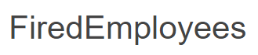
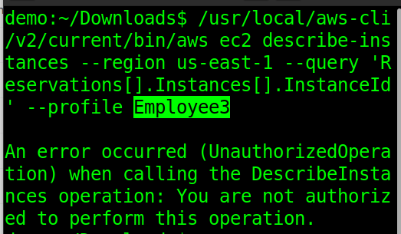
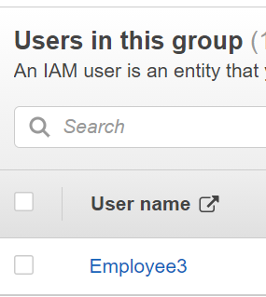
Terminated Access Correctly Denied

Slide 40
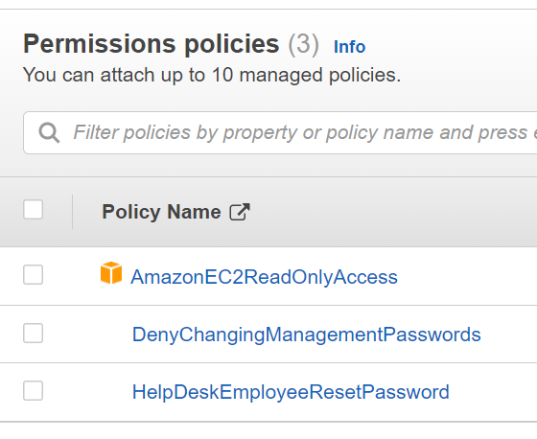
Dive into Group - RegularEmployees

Slide 41
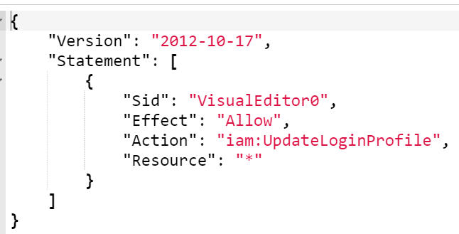
HelpDeskEmployeeResetPassword
Part of their help desk job

Slide 42
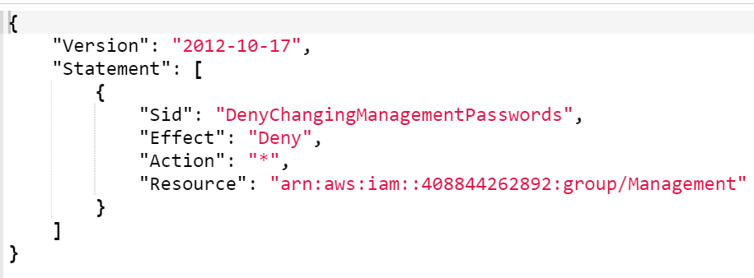
Protect Management (Full Admins)

Slide 43
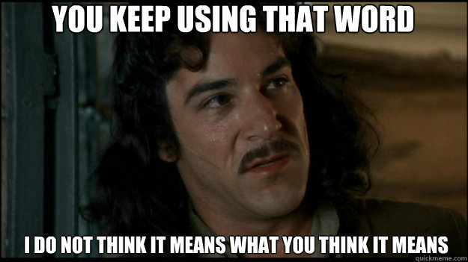
Denied a “Group”

Slide 44
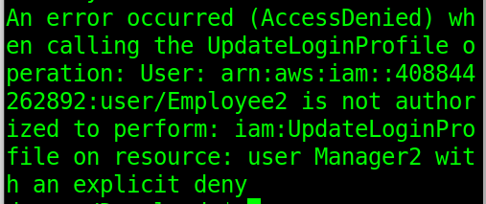
What We Expect

Slide 45
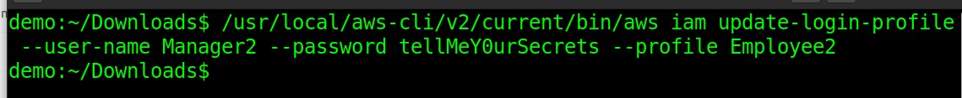
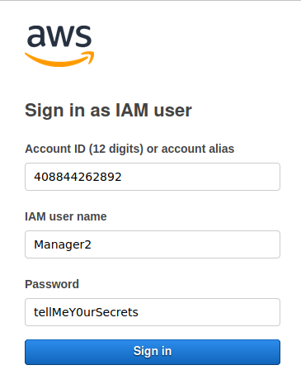
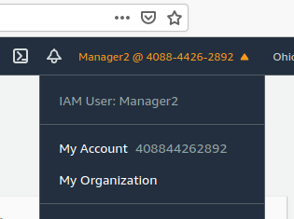
What We Actually Get
No error message at all!

Slide 46
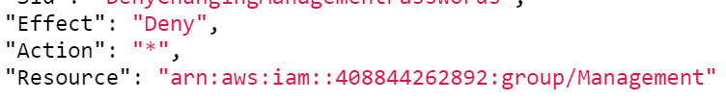
But Why?
“AWS treats groups as a separate object, and they don’t treat a user as part of a group when it comes to deny rules.”
We were only denying access when passing the “Resource” group/Management to an API call.
What did we pass to iam:UpdateLoginProfile ?
--user-name Manager2
Which translates to:
arn:aws:iam::408844262892:user/Manager2

Slide 47
IAM - Protections
Won’t lie, IAM can get complex
Ask for help if you need it or even for a second opinion
Tools to help
Access Advisor (comes built-in with AWS)
IAM Policy Simulator (comes built-in with AWS)

Slide 48
API Key Theft and Backdoors to Watch Out for
How’d they steal my creds?
Source repository with hard-coded credentials
Github and AWS actually auto-scan for this now
AWS may auto-disable those exposed credentials
https://docs.github.com/en/code-security/secret-security/about-secret-scanning
Unprotected object storage (e.g. buckets)
SSRF, Web app vulns
Phishing

Slide 49
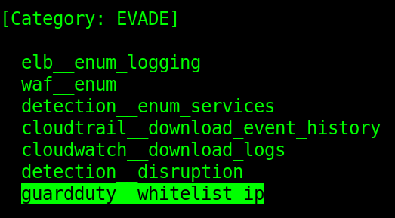

Backdoors
Pacu tool

Slide 50

Backdoors
IAM
Compute
Containers
Lambda code
Resource policies (e.g. buckets, KMS)
Security groups
VPC configurations
VPN keys
EBS Snapshots
https://endgame.readthedocs.io/en/latest/
Single command account takeover tool
https://tenor.com/view/oh-my-god-ilove-lucy-omg-shocked-wide-eyes-gif-15506747

Slide 51
Backdoor Intrusion Detection
Monitor and alert for any IAM user
Creation
Policy or Role change
Watch for compute stolen credential usage
Compute instance credential used outside of your VPC
Daily audit of configuration changes
AWS Config tool can help

Slide 52
How to Close the Backdoor?
Contact cloud support to help suspend the account
Incident response if you can’t get control quickly
May save you unauthorized charges on your bill
Might be faster to open a new account
You did leverage “cloud aware” apps right?
You pay for cloud, so use cloudy tools to deploy quickly from scratch
Assuming the attacker didn’t leave traps
An attacker could use cloud triggers to delete your stuff
If you suspect this get extra help from specialists
Time to dig out your “root” user
You did have MFA and a password safe I hope
Vendor Guidelines
https://aws.amazon.com/premiumsupport/knowledge-center/potential-account-compromise/
https://cloud.google.com/security/compromised-credentials

Slide 53
Handling Backdoors
Again, a new account might be easier
Start with IAM first
Policies, Roles, Users
Perhaps run a script to quickly lock everything using your root credential
Consult AWS Access Advisor
CloudTrail logs
Assuming the attacker didn’t delete logs 😬
Review your bill
Won’t show very recent (hours ago) activity
Verify your backups/snapshots
Proactive - Prevent backups from deletion (Glacier Vault locks)

Slide 54
JSONP Theft (SaaS)
Not just IaaS with vulnerabilities
Despite all those sales pitches on SaaS!
JSON
Popular data interchange format
Friendly for REST APIs and front-end JavaScript frameworks
JSONP
JSON with Padding
Facilitate cross-domain data sharing

Slide 55

JSON vs JSONP
JSON
JSONP
// JavaScript response to HTTP request
google.visualization.Query.setResponse("{\"employees\":[{\"firstName\":\"John\",\"lastName\":\"Doe\"},{\"firstName\":\"Anna\",\"lastName\":\"Smith\"},{\"firstName\":\"Peter\",\"lastName\":\"Jones\"}]}");

Slide 56

JSON(P) Hijacking
Happened to Gmail, Yahoo Mail
Google Spreadsheets
Google Spreadsheet Vuln - CSRF and JSON Hijacking allows data theft
SaaS vulnerability from 2015

Slide 57

Victim’s Sensitive Data

Slide 58

Attacker Gets This

Slide 59

Exploit Code

Slide 60
Morale of JSONP / SaaS?
Don’t get complacent just because your cloud solution is SaaS
Did your vendor get a pen test?
What is the customer’s (your) responsibility?
For securing their account?
For incident response?

Slide 61

Supply Chain Vulnerabilities
https://www.zdnet.com/article/malicious-npm-packages-caught-installing-remote-access-trojans/
* Not just npm, but also Java, Python, etc.

Slide 62
Defense
Dependency control
Offer an internal-only official repository
Not in the company approved repository, gotta make a request
Yet security needs to respond quickly to complete reviews
Code builds should fail if attempting to use a public repository
Screen for approved versions installed
Bonus is a central place to review third party dependency usage
Review new versions before upgrading
Also do a signature check that current versions have not been tampered with
Embed third party libs into the project code base
Not very scalable for larger projects/enterprises
May make applying even minor library upgrades harder
A possible alternative for smaller projects/budgets

Slide 63
Lack of MFA
Some folks don’t bother
Just a test account
Confusing options?
Do I use a virtual or a physical device
In last few years it has gotten easier to setup though
Heavy API users
Not aware that MFA can still be used

Slide 64

Why MFA? - Phishing
https://www.techrepublic.com/article/phishing-attack-impersonates-amazon-web-services-to-steal-user-credentials/
Image: Abnormal Security

Slide 65
Password Reset Attacks
Attacker must compromise your e-mail
Did you 2FA protect your email account?
Attacker can then reset your root credential
Protections:
Use a dedicated email address that is not known/guessable
Ensure your 2FA is also setup for that email account
Don’t let SMS recovery be an option

Slide 66
Federation/SAML Attacks
You have MFA, strong passwords, federated identity
Attackers may target your technology platform
SolarWinds - targeted organization’s identity provider
Cloud service trusts what your identity provider says about the user
Didn’t require cracking users passwords
Didn’t require having the MFA device
VPN Vulnerabilities
Don’t assume your internal network is safe
Multi-factor authentication could be bypassed for the VPN too
Takeaway: Patch your stuff too and use MFA

Slide 67

IAM Policy for MFA
Deny actions unless MFA is present
Except those actions needed to setup MFA
(this is not for federated identities)
AWS: Allows MFA-authenticated IAM users to manage their own credentials on the My Security Credentials page https://docs.aws.amazon.com/IAM/latest/UserGuide/reference_policies_examples_aws_my-sec-creds-self-manage.html

Slide 68

MFA with API Calls
Useful for developers using API keys to do day-to-day tasks.
Appropriate if a human is expected to authenticate daily.
For Compute instances you would use instance roles instead and not MFA credentials.
aws sts get-session-token \
--serial-number
arn:aws:iam::123456789012:mfa/user --token-code 123456
https://docs.aws.amazon.com/IAM/latest/UserGuide/id_credentials_mfa_configure-api-require.html https://aws.amazon.com/premiumsupport/knowledge-center/authenticate-mfa-cli/
Notes:
You could go hard-core security and for service accounts also have a virtual software otp in addition to api secret keys. More work to setup but technically possible. Although you’d probably benefit more from a regular credential rotation.

Slide 69
Summary
Attackers do attack “The Cloud”
Constant Vigilance, Mr. Potter
Defensive tools are available
Customer shared responsibility
Even for SaaS
Validate your security assumptions
Was it pen tested?
Attackers can’t get in here
Can you detect intrusions if your assumption is wrong?

Slide 70
References
https://github.com/RhinoSecurityLabs/cloudgoat
Practice in a vulnerable cloud environment
Some slide clipart care of https://openclipart.org/

